Slide 1

AUTOMATE
A Step towards adaptive smart learning

Slide 2

AUTOMATE
Automate is a desktop application for the students who never wants to miss a class.
Automate provides a good user interface from which students can schedule their classes for a complete week and the same schedule can be repeated for the further weeks.
Automate is a startup application and always runs in background.
students can schedule their each day with simple three step process.

Slide 3
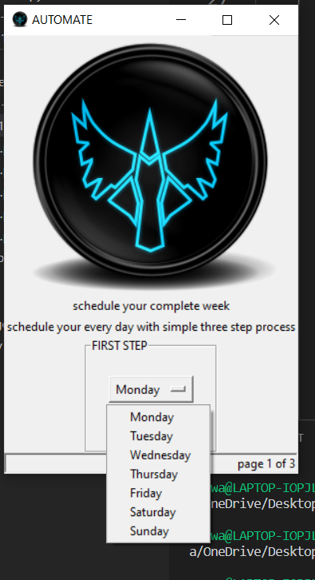
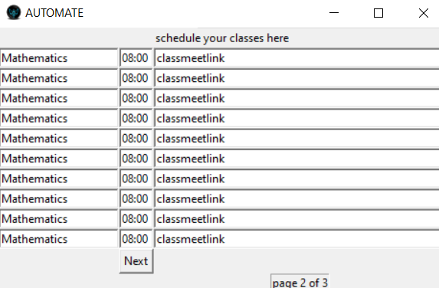
Automation of student workflow with Automate
Our application automatically opens the class meet link at the scheduled time without user interaction.

Slide 4
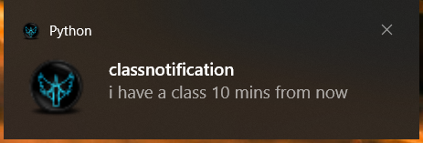
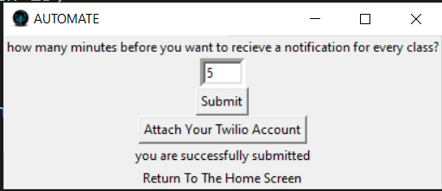
our application acts a class reminder
pops up a desktop notification before a few minutes
of every class ..and the time for the notification can
be scheduled the student itself .

Slide 5
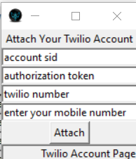
Students can attach their Twilio account to our application , so that they can get class reminders directly to their phone as an SMS

Slide 6
Python FACE TRACKER script
using face tracker we make sure that user pays equal amount of attention.
we position the face and notify the host if the user is not looking at the screen
this will create a method of conducting online exams with almost same vigilance as an offline examination
Thank You

